Slide 1
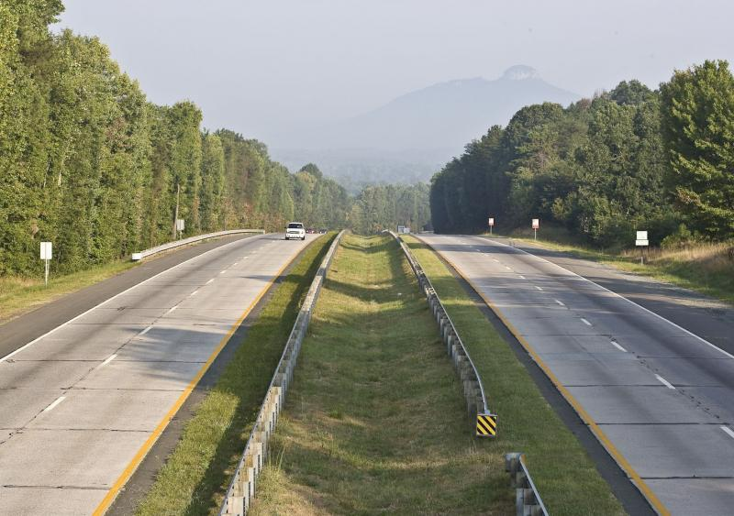
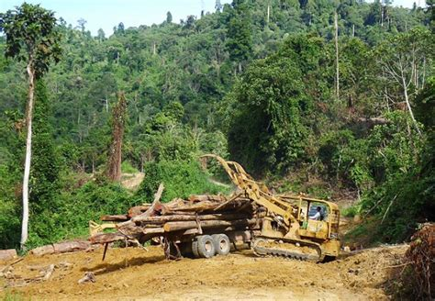
Case study: Human disturbances effect on global plant functional diversity
<number>

Slide 2
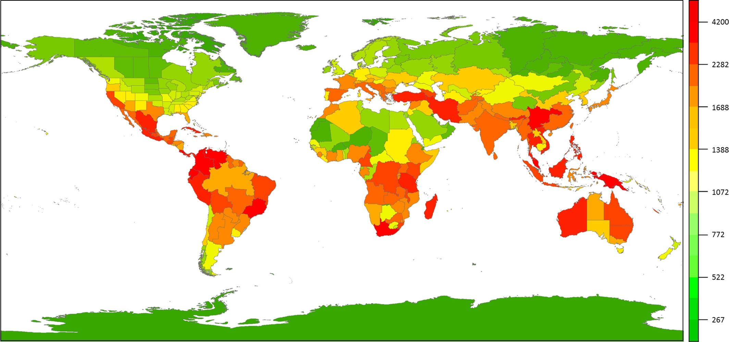
Plant diversity is known but lesser global functional diversity
<number>

Slide 3
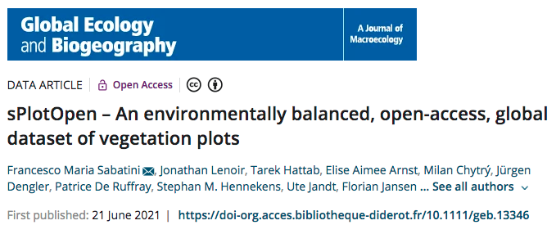
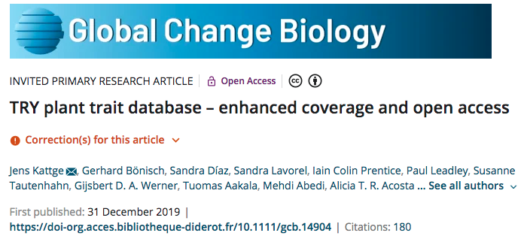
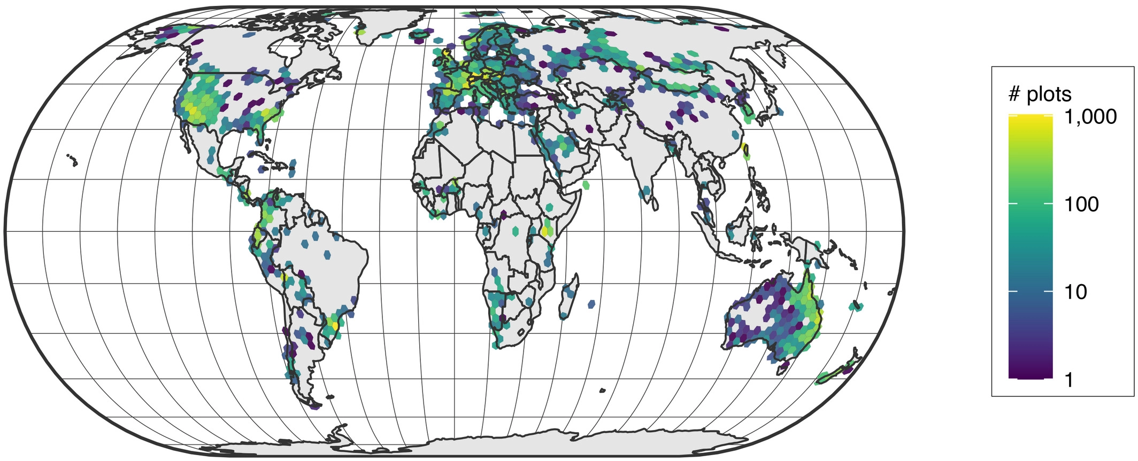
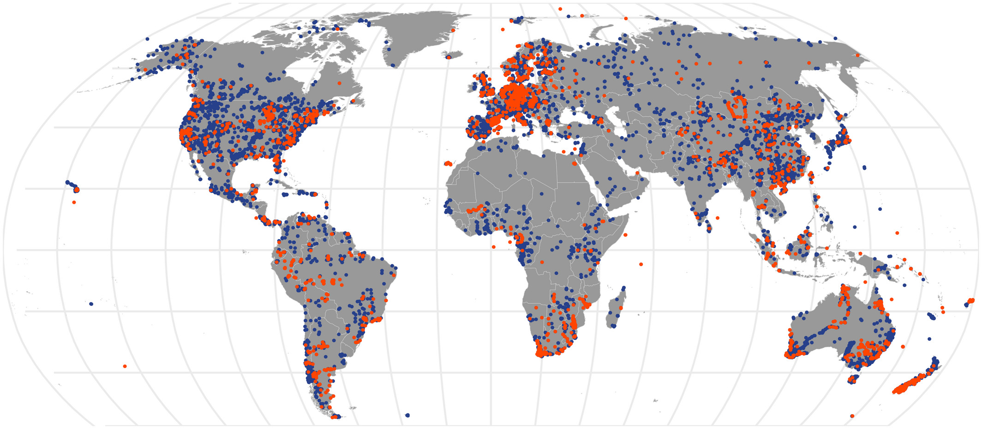
Leverage open data sets
<number>

Slide 4
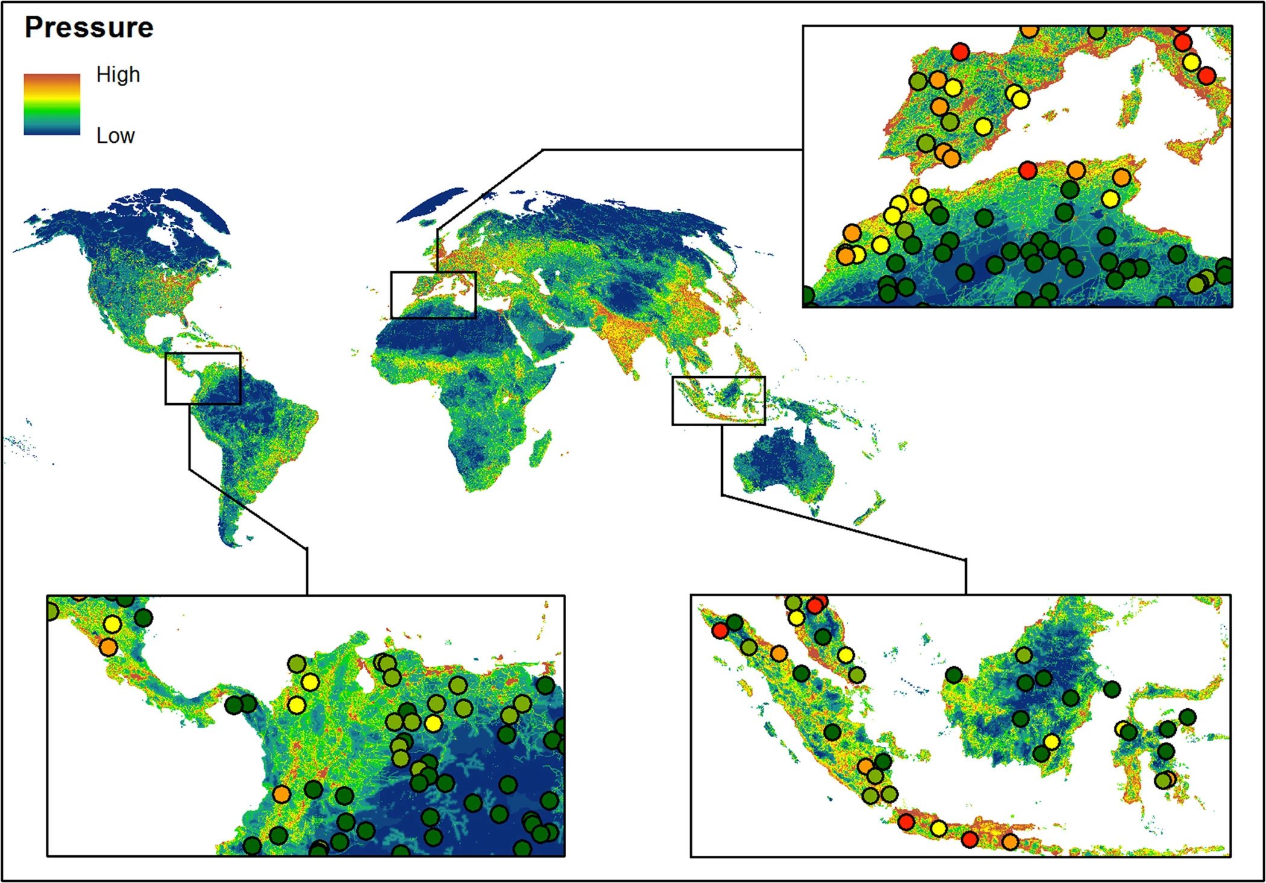
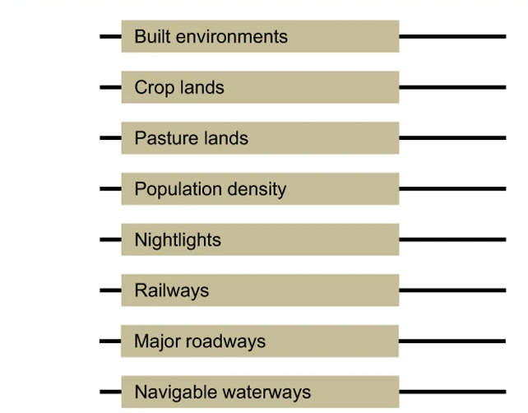
Inspect different aspects of human disturbances
<number>

Slide 5
How human impact plant functional diversity globally?
Q1: Is there a link between disturbance level and functional diversity?
Q1bis: For what type of disturbance?
Q1ter: Are there specific links between some functional diversity facets and specific type of disturbances?
Q2: Are there relationships between disturbance and functional diversity across different ecosystems (boreal, temperate, tropical)? Q2bis: What about at different scales? (global vs. ecoregion)
<number>

